Slide 1



a00s3e3 - DONE
F= -1.77969
F = -1.77893
F= -1.77588, unstable

Slide 2










a00s5e3 - DONE
F = -2.986
F = -2.98574
F = -2.98733
F = -2.98580
F = -2.98637
F = -2.98644

Slide 3


a00s6e3 - DONE
F = -3.59170
F = -3.59404

Slide 4


a00s7e3 - DONE
F = -4.20090
F = -4.20224
Terran tried stripe (15.2, 20.2) & (12.2, 20.2). Unstable

Slide 5



a05s3e3 - DONE
F = -1.77283
F = -1.77232
F = -1.77005

Slide 6



a05s5e3
F = -2.97229
F = -2.97422
F = -2.97365

Slide 7
a05s75e3
str
hol
hom

Slide 8
a05s010
str
hol
hom

Slide 9



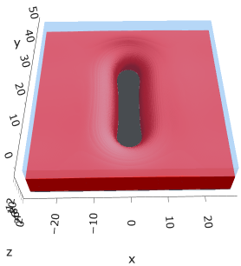

a10s5e3 - DONE
F = -2.93788
F = -2.93873
F = -2.93788

Slide 10

a20s5e3
F = -2.82020
No hol mic?

Slide 11
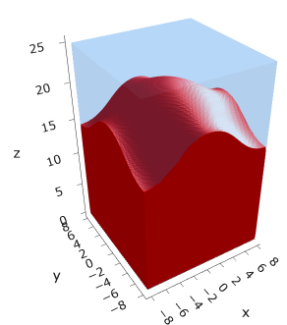
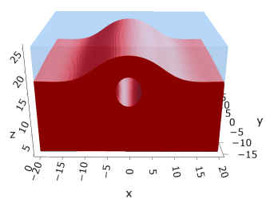
a20s015
F = -8.43926
F = -8.43806

Slide 12



a20s022
F = -12.3420
F = -12.3429
F = -12.3433

Slide 13

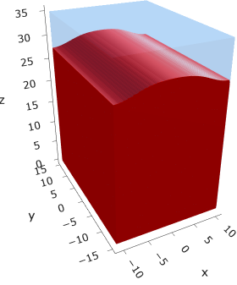


a20s025
F = -14.0028
F = -14.0028
F = -14.0033
F = -13.9755

Slide 14




a20s027
F = -15.1049
F = -15.1047
F = -15.0898
F = -15.1050

Slide 15

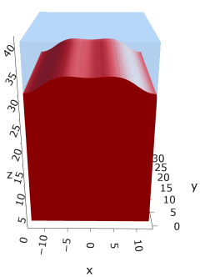

a25s027
F = -14.6022
F = -14.6016
F = -14.6015
Mul seems unstable (separation between layers low)

Slide 16

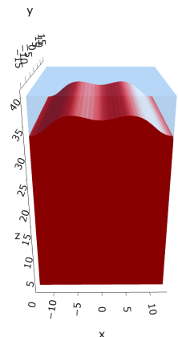

a25s030
F = -16.1887
F = -16.1855
F = -16.1894
Mul seems unstable

Slide 17
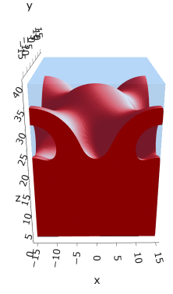


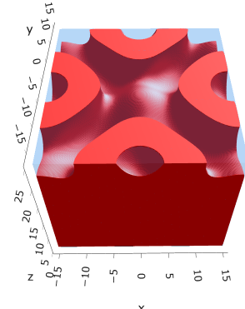
a30s020
F = -10.4931
F = -10.4878
F = -10.4764
Hom seems unstable for (0.4, 0.4)

Slide 18


a30s025
F = -13.0394
F = -13.0538
cyl
Mul seems unstable

Slide 19
a30s030
str
mul
hom

Slide 20
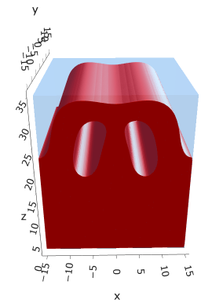

a325s020
F = -10.2983
F = -10.2821

Slide 21



a35s020
3 “layers”
+1 dilute layer < isomin = 0.1

Slide 22





a35
s10
s12
s15
s18

Slide 23



Parallelization
$$α=0, χ=1.25, N=50, σ=0.02$$
$$α=0, χ=1.25, N=200, σ=0.005$$
$$L_{x}=L_{y}=23, { L}_{z}=15$$
Nth = 12: 500 it, 4.3 hrs
Nth = 8 : 500 it, 6.9 hrs
Nth = 6 : 415 it, 20 hrs (poss. mem bottleneck)

Slide 24







Exercise: Micelle / Stripe
s = 5e-03, N = 50, a = 0.0, x = 1.0
s = 5e-03, N = 75, a = 0.0, x = 1.0
Isosurface at pha = 0.1

Slide 25






a040x170s020

Slide 26






a040x170s010

Slide 27

a040x170s025

Slide 28














a040x170s022

Slide 29










a040x170 seed
See if becomes hex
cyl4-975
cyl4-12
cyl16-975
cyl16-1025
cyl1

Slide 30






a040x170s017

Slide 31












































a040x170s015 seed
Almost done
Almost done

Slide 32

















a040x170s013

Slide 33
















a040x170s010 seed

Slide 34














X200 x170 x130 x120 x100
F = −10.24458
F = − 9.14301
F = −11.0057
F = −10.2429
F = −11.0015
F = −9.63949
F = −10.2461
F = −10.9948
F = − 9.63030
F = −10.2431
F = −10.9953

Slide 35





a040x100 relaxation

Slide 36








































a040x100 seed
old
old

Slide 37


a040x120 relaxation
F = −10.24458

Slide 38





































a040x120 seed
cyl16-850
cyl16-825

Slide 39






a040x130 relaxation

Slide 40




a040x170 relaxation
F = −9.10347
1 neck

Slide 41







a040x200 relaxation

Slide 42










a040x200 seed
Note: not completely converged but stopped for resources

Slide 44


a0.40 x1.70

Slide 45





Zhulina JCP 1998
a = 0.01
0.1 mM
1 mM
May need to init using sine
10 mM
25 mM
Zhulina NVT; current GCE runs at Lz = 20

Slide 46

Carrillo Langmuir 2009

Slide 47

Parallelization

Slide 48
Equations
Quenched average, np, A --> \inf ; np/A → \sigma
Discrete Gaussian chain

Slide 49




Scaling (Alexander—de Gennes brush)
V = 4.2; H = 27.5 – 30.5
V = 2; H = 39 – 45.5

Slide 50






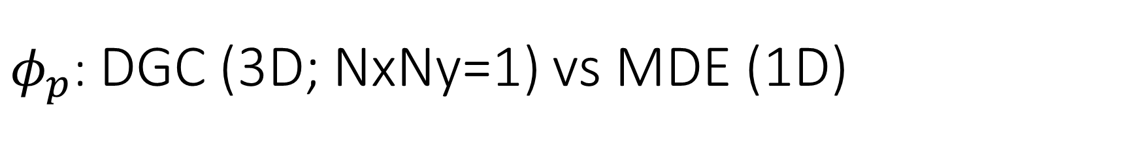
$φ_{p}$: DGC (3D; NxNy=1) vs MDE (1D)
Ns/sigs: dz = 0.10, Ngz_2 = 4$σ$; Chis/bs: dz = 0.25, Ngz_2 = 3.5$σ$

Slide 51


Numericals
Ys
Possibly do Ngz for multiple dzs

Slide 52








3D
Lxy = 1
Lxy = 10
Lxy = 5
Lxy = 15
y-z heatmaps for $φ_{p}$ at constant x

Slide 53





z-FFT vs z-FD (MDE) – REDFT01 xy(z)
Lx = 5, Ly = 5, Lz = 50. s = 0.02. x = 0.75. a = 0.00, N = 50
3D vs 1D (dashed): dz = 0.5, ds = 0.20; dz_1D = 0.113, ds_1D = 0.083
FFT (xyz)
FFT (yz vs pha)
FD (xyz)
FD (yz vs pha)
Diff btw 1D/3D should just be dz, ds, etc.

Slide 54
Specifying Grafted Points

Slide 55
Strategy
2D binary array for surface sites of homogeneously grafted polymer given grafting density, simulation box size, and discretization (and assuming dx = dy)
Fullspace must be periodic on x0 = xL, y0 = yL
Halfspace must be even on xL/2 and yL/2 (overlap of boundary following REDFT00) and periodic on x0 = xL, y0 = yL.
Homogeneous spacing as determined by regular hexagon, where grafting point at centroid of hexagon
In case there are edge effects, try shifting the centroids away from the boundaries of the xy-plane (only did for fullspace)
Make sure no edge effects by comparing results of full FFT with cos FFT

Slide 56
Test conditions
Sigma = 0.05 c/nm2
Lx = 15 nm
Ly = 15 nm
dx = 0.4 nm
Cast in terms of dx (for rounding and PBC for grafting points):
Sigma = 0.0668 c/nm2
Lx = 14.80 nm
Ly = 11.20 nm
(Sigma error decrease with dx)

Slide 57

Padded PBC (Full FFT)
Hexagons drawn for illustration of hexagon approach

Slide 58

Unpadded PBC (Full/Cos FFT)

Slide 59






Other conditions (full and half results overlapped to show match)
s = 0.0241 (20.28%; dx=0.4), Lx, Ly = 12.40, 20.80
s = 0.0208 (4.08%; dx=0.1), Lx, Ly = 12.90, 22.30
s = 0.1332 (11%; dx=0.1), Lx, Ly = 20.50, 20.40

